Slide 1

Project Presentation
on
“Attendance Management System Using Face Detection ”
Presented By:
Aditya Sharma
18EJCCS007
8CSA
Submitted to:
Ms. B.Uma Maheswari
Asst. professor, CSE
Dr. Sanjay Gaur
HOD, CSE

Slide 2
Contents
Description of Technology
Implementation modules
Facial image Capturing
Steps of Implementation
Data Flow Diagram
Sample code & Outputs
Conclusion

Slide 3
Description of Technology
This project is about the biometric attendance management.
The automatic attendance management will replace the manual method, which takes a lot of time consuming and difficult to maintain.
There are many biometric processes, in that face recognition is the best method.
User’s emotion is recognized using its facial expressions

Slide 4
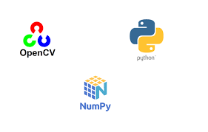
Implementation Modules:
The data set is trained with:
OpenCV
Keras and Python's numpy module;
Tflearn and Tensor Flow are used to recognise the emotions.

Slide 5
Face image Capturing
There are four classifications of techniques that are utilized to distinguish human face, to be specific:
1. Feature Method: Based on facial features like the placement of eyes, nose, contour.
2. Knowledge Method: Pre-Trained Models as we instill our model with data sets.
3. Appearance Method: Based on Neural Networks approach
4. Template Method: Checks for the correlation between the standard image and input image face pattern

Slide 6
Steps in Implementation
A. Primary database creation and training
. B. Recognizing and Pre-Processing:
• Converting picture to grayscale
• Pixel Transformation
• Geometric Transformation
C. Enlisting Face
D. Image Matching Phase
Attendance Marking Phase
E. Preparing Database and Testing Database

Slide 7
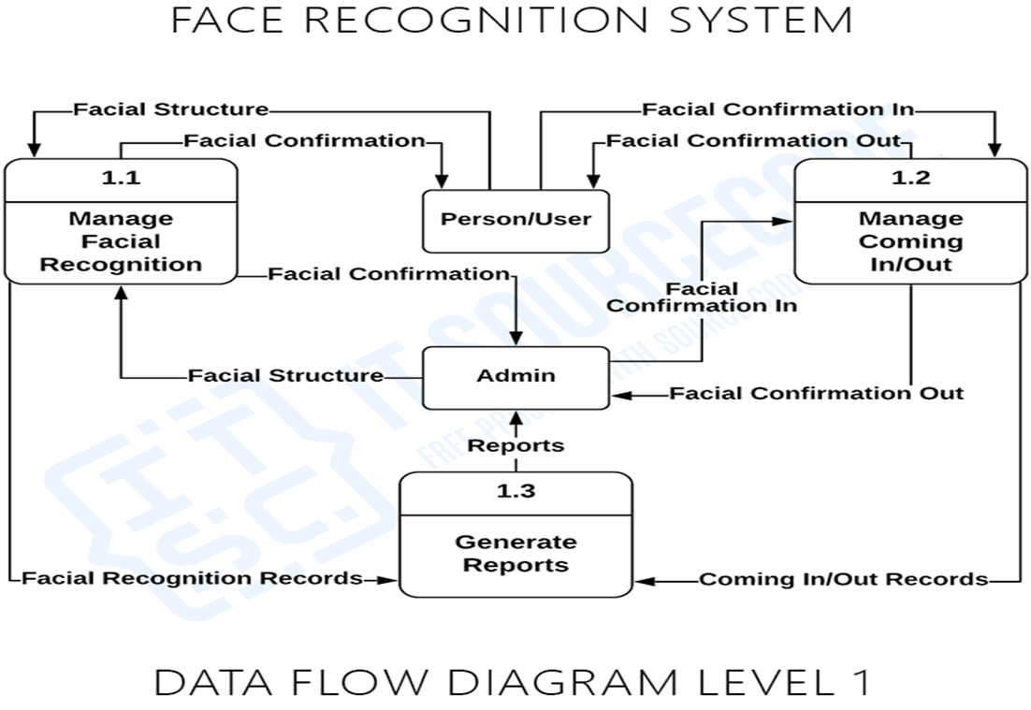
Data Flow Diagram

Slide 8
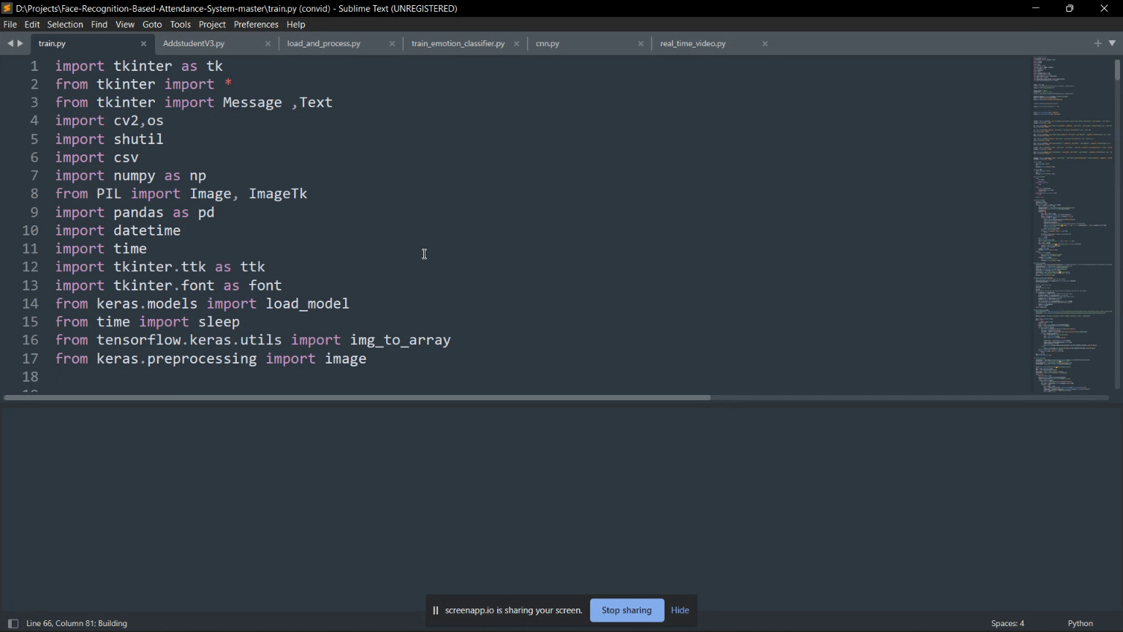
Code Snaps:

Slide 9
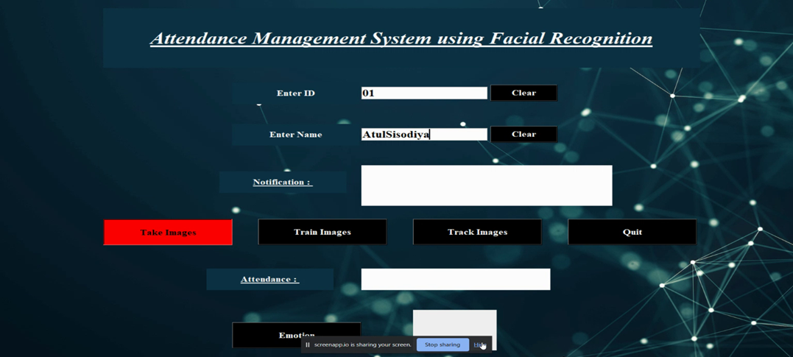
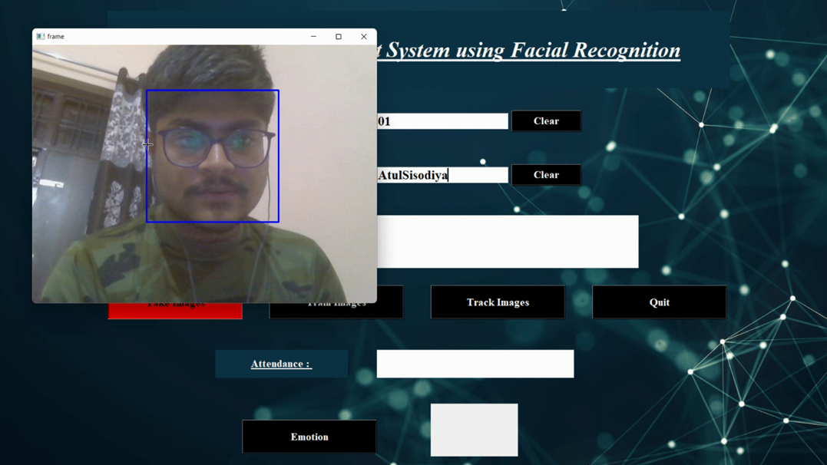
Output Snaps: Enter Data and training image

Slide 10
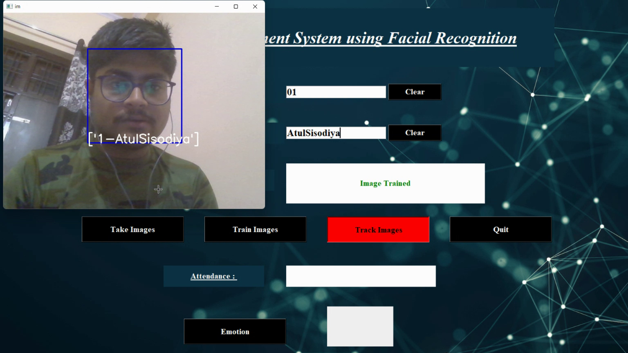
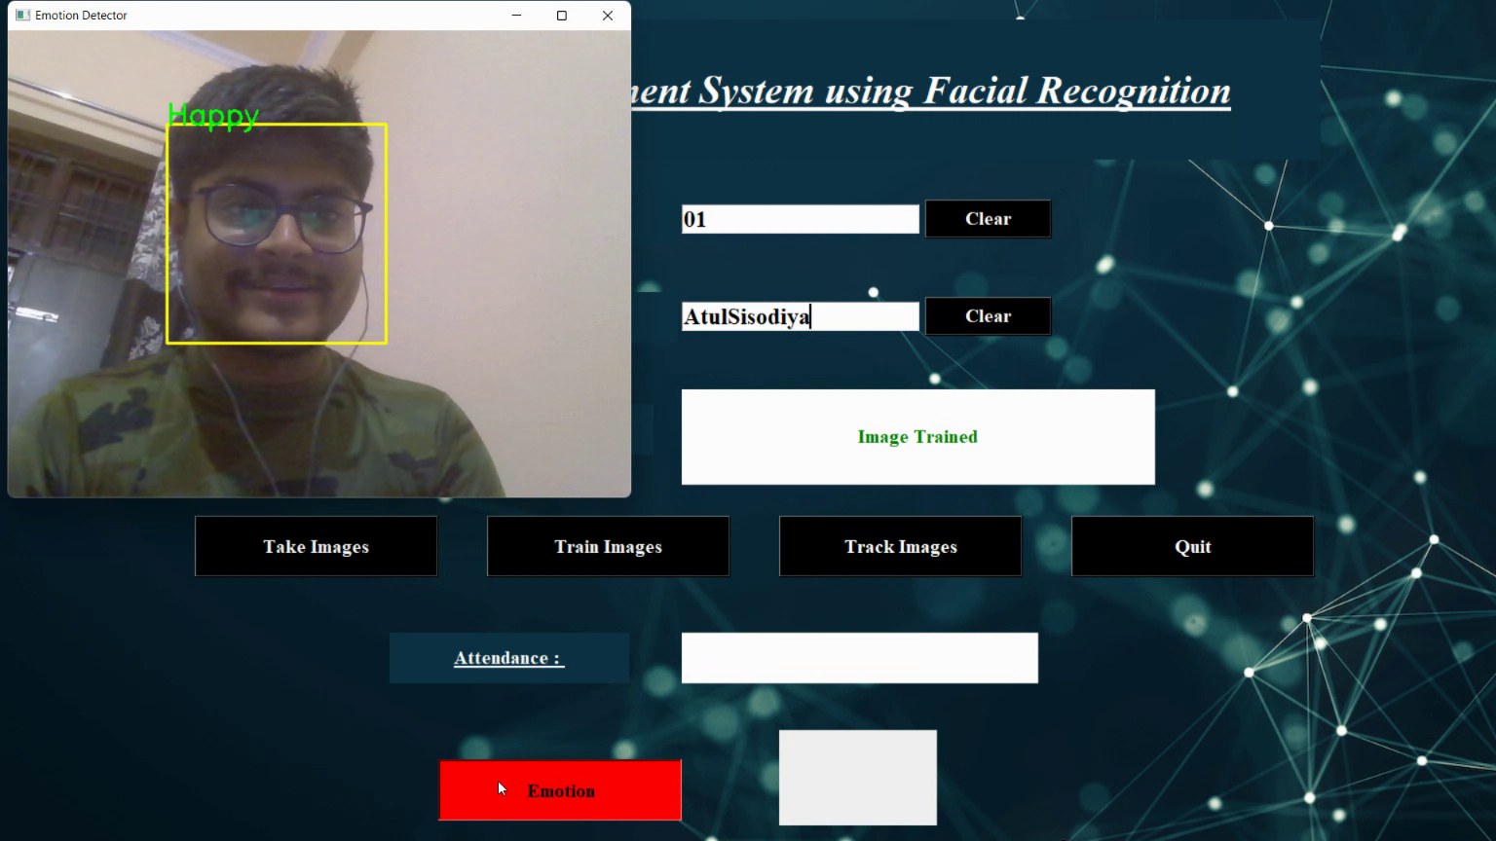
Live Emotion Detection :
Tracking image:

Slide 11
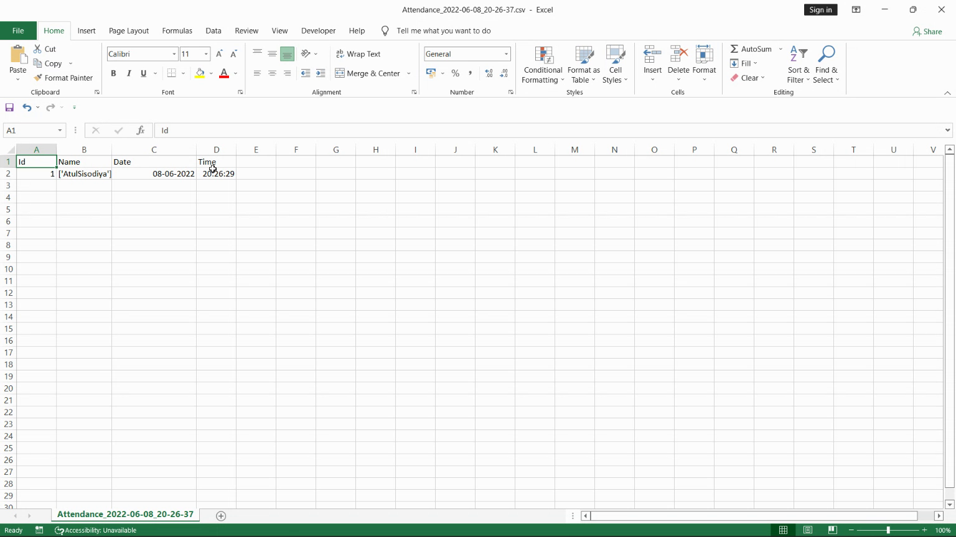
Excel Sheet to store attendance:

Slide 12
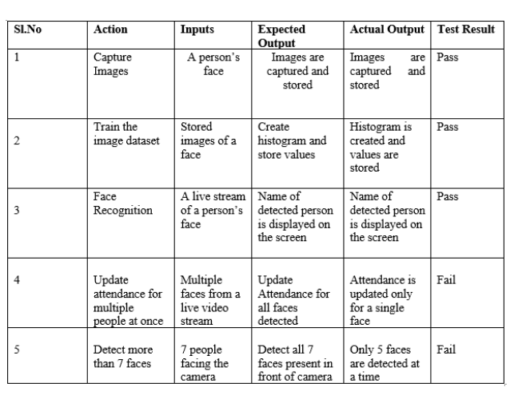
Test Case:

Slide 13
Conclusion:
This project presents a simple yet eﬃcient approach to calculate the attendance in a class by employing facial recognition techniques. The output of this system can be out-lined as follows:
. The system also successfully recognizes and marks the at-tendance of the detected students. We wish to implement an eﬃcient, time saving and easy to operate system which will in turn beneﬁt both faculty and students.
Live Emotion Detection is also an added feature.

Slide 14
THANK YOU

